Slide 1
Intro to cloud
Nand Kishore Ola​
NIT Jalandhar
LinkedIn
20-04-2023

Slide 2
AGENDA
Nand Kishore Ola​
Introduction​
Ec2 Machine
​Storage on AWS
Scalable system
​Deployment
​Security
Price optimization

Slide 3
Ec2
Nand Kishore Ola​
Amazon Elastic Compute Cloud (EC2) is a web service that provides resizable compute capacity in the cloud. In simpler terms, EC2 allows you to rent virtual servers (called instances) from Amazon's cloud infrastructure, which you can use to run your applications or services. You can choose the instance type based on your needs, whether it's for general-purpose computing, memory-intensive tasks, or high-performance computing.

Slide 4
Ec2
Nand Kishore Ola​
Amazon Elastic Compute Cloud (EC2) is a web service that provides resizable compute capacity in the cloud. In simpler terms, EC2 allows you to rent virtual servers (called instances) from Amazon's cloud infrastructure, which you can use to run your applications or services. You can choose the instance type based on your needs, whether it's for general-purpose computing, memory-intensive tasks, or high-performance computing.

Slide 5
How to create
Nand Kishore Ola​
EC2 Machine

Slide 6
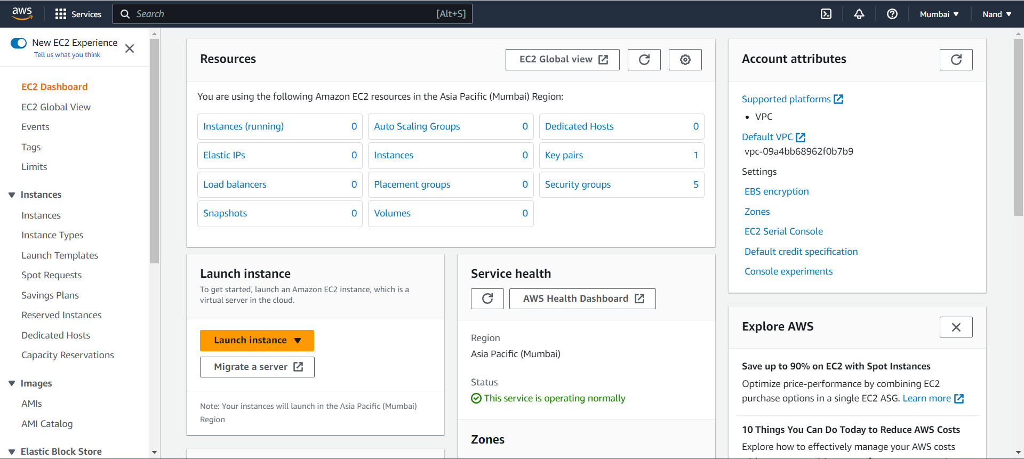
Ec2 Dashboard
Nand Kishore Ola​

Slide 7
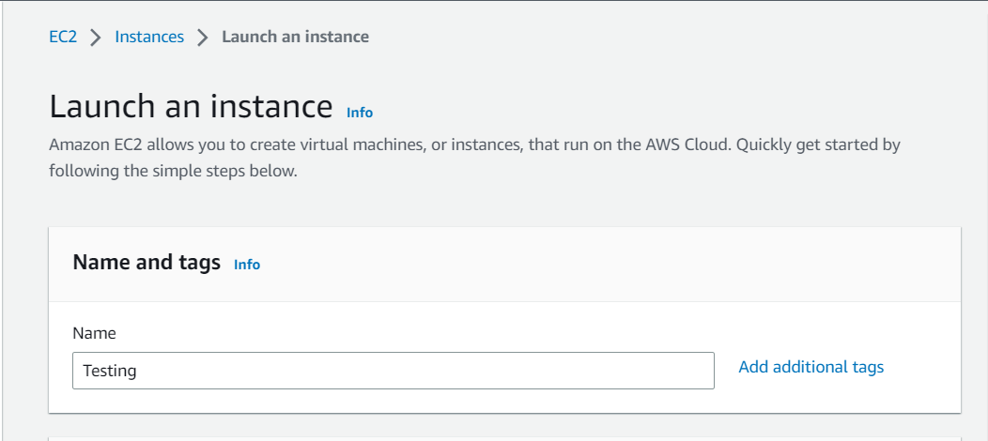
Naming of Instance
Nand Kishore Ola​

Slide 8
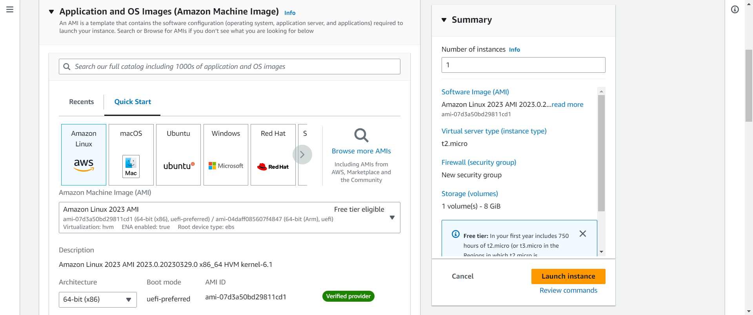
OS Types
Nand Kishore Ola​

Slide 9
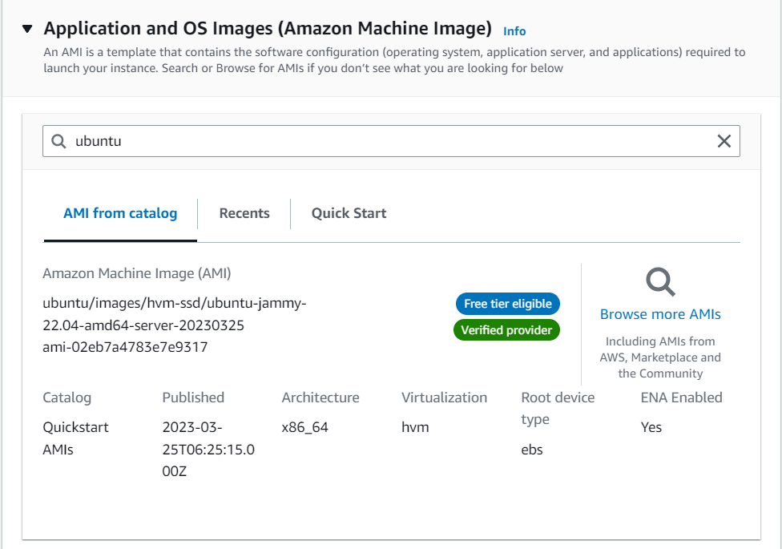
Os Types
Nand Kishore Ola​

Slide 10
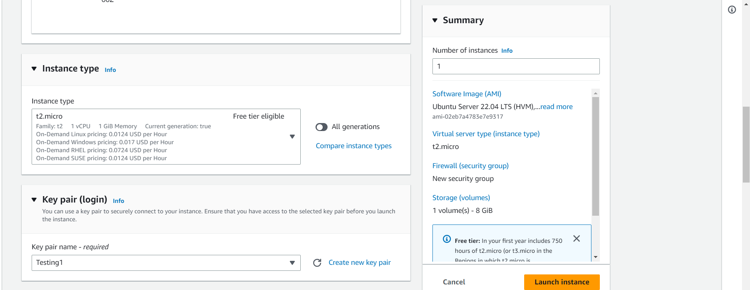
Instance Types
Nand Kishore Ola​

Slide 11
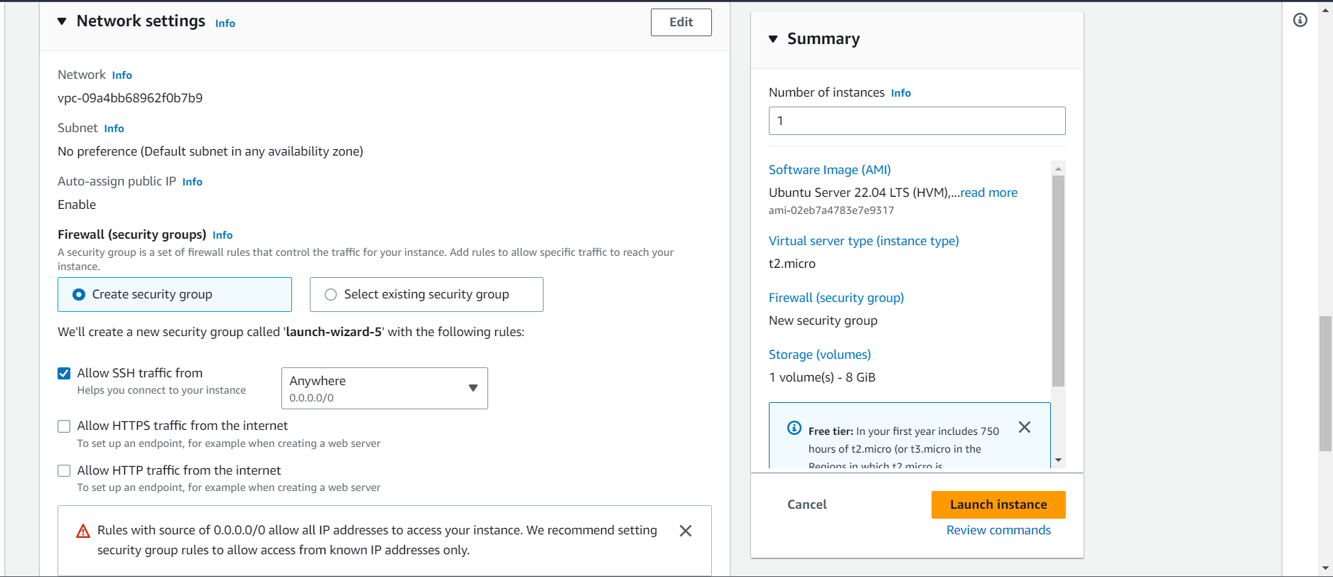
Network Setting for traffic
Nand Kishore Ola​

Slide 12
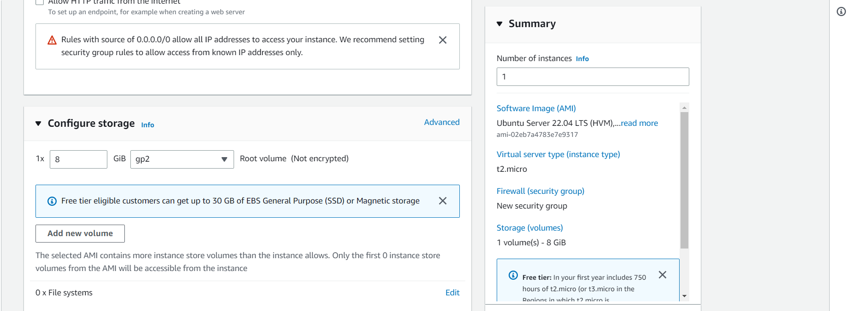
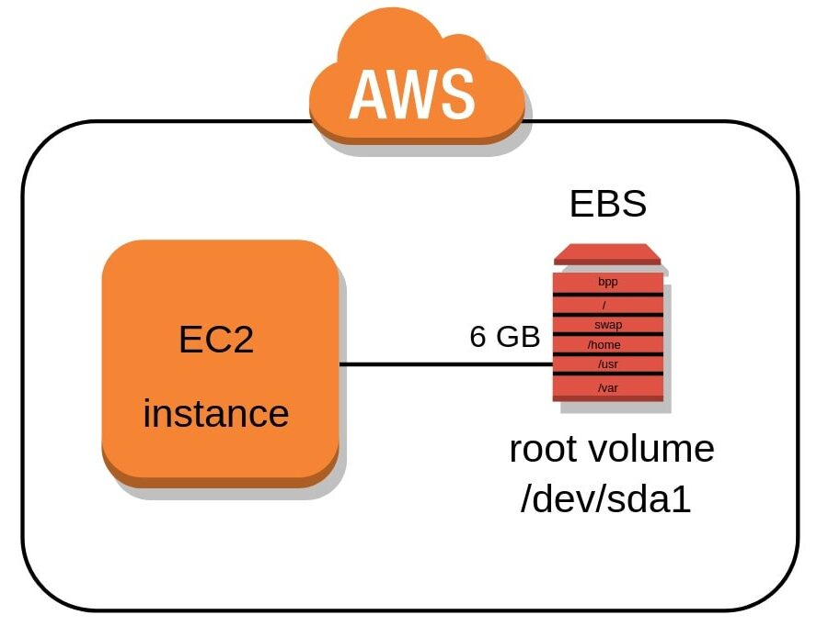
Storage to install OS on EC2
Nand Kishore Ola​

Slide 13
Nand Kishore Ola​

Slide 14
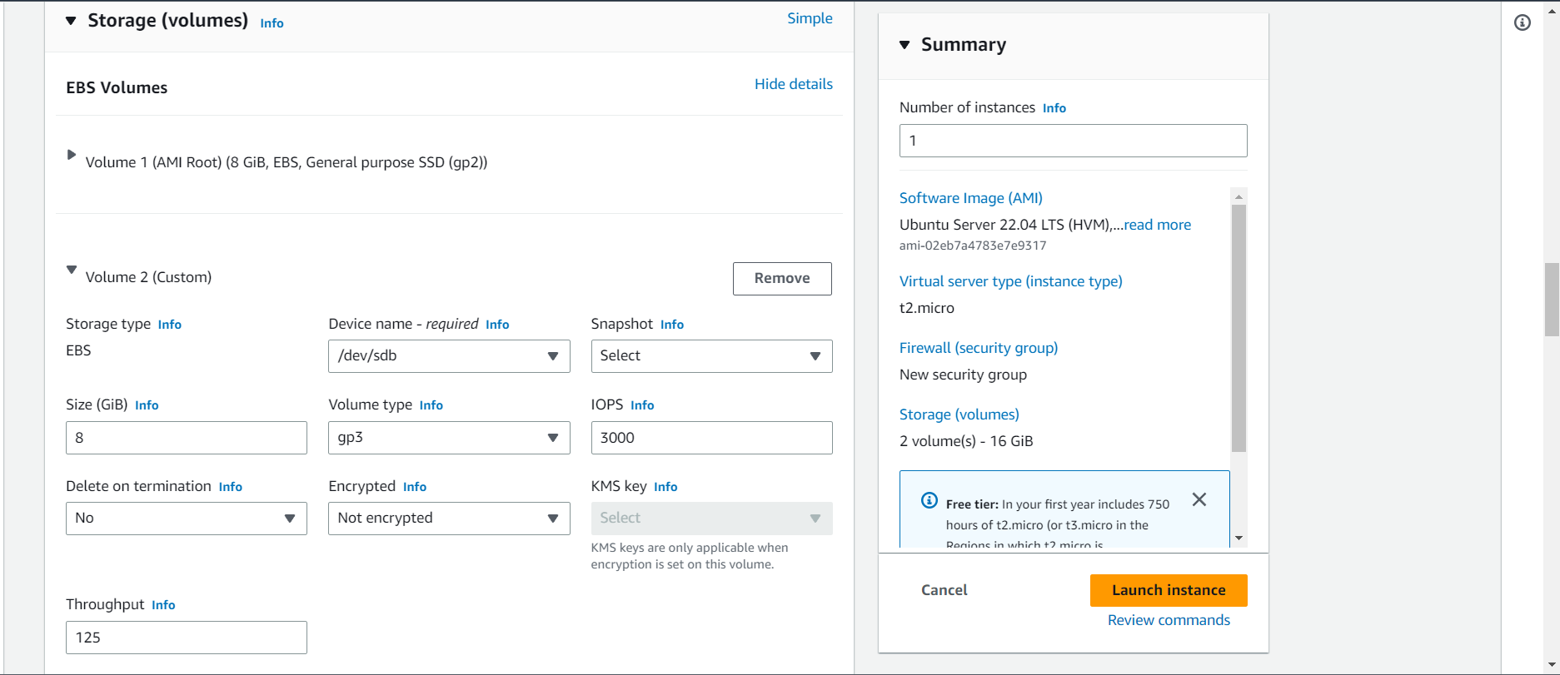
Advance volume settings
Nand Kishore Ola​

Slide 15
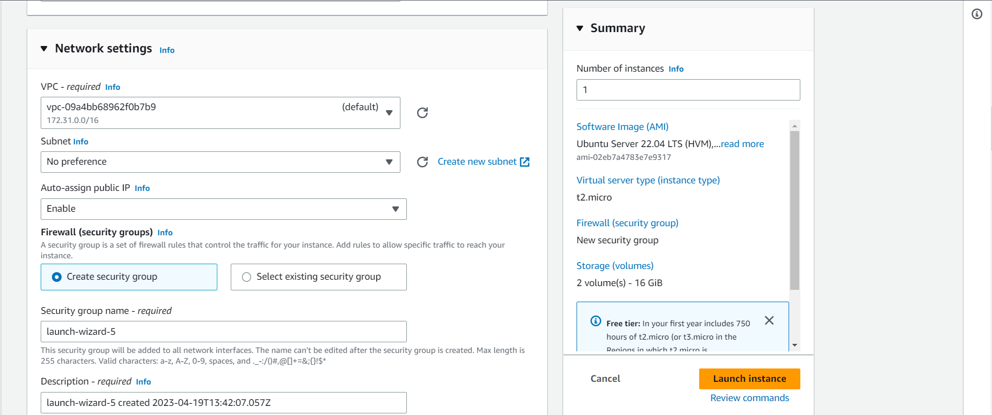
Advance network settings Virtual Private Cloud
Nand Kishore Ola​

Slide 16
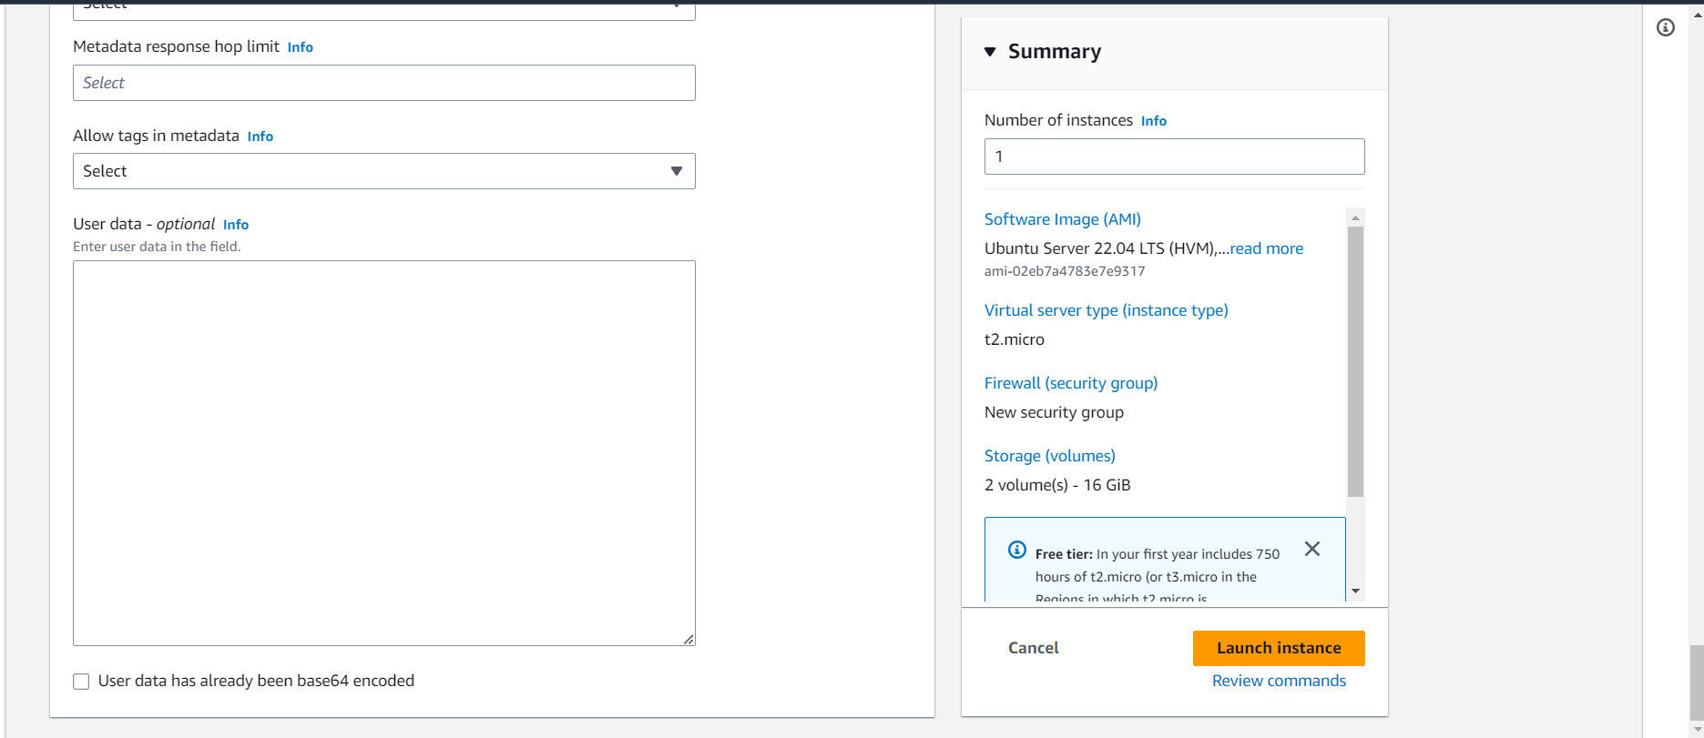
Advance pre-configuration
Nand Kishore Ola​

Slide 17
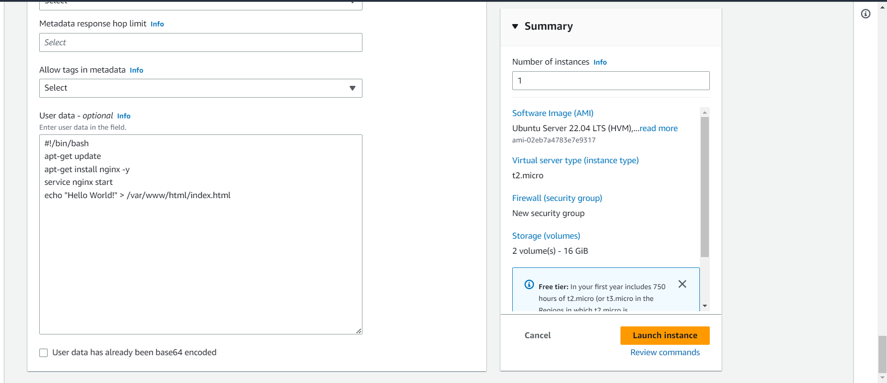
Bash Script(as Root user be careful)
Nand Kishore Ola​

Slide 18
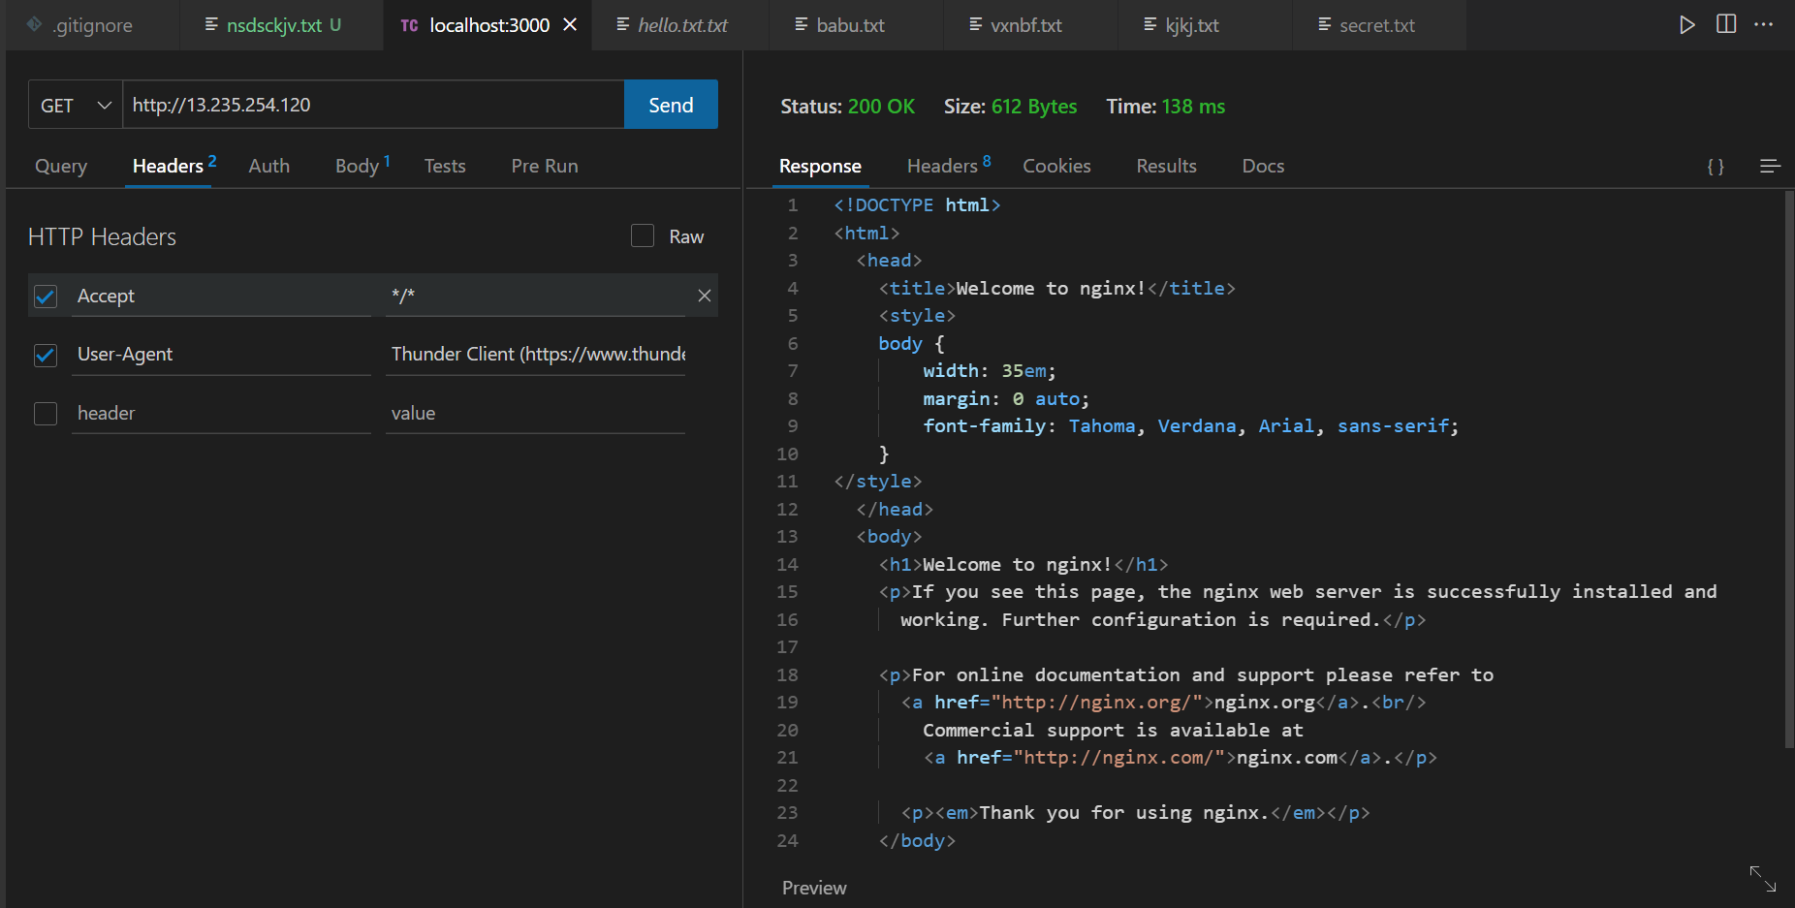
Response from Ec2
Nand Kishore Ola​

Slide 19
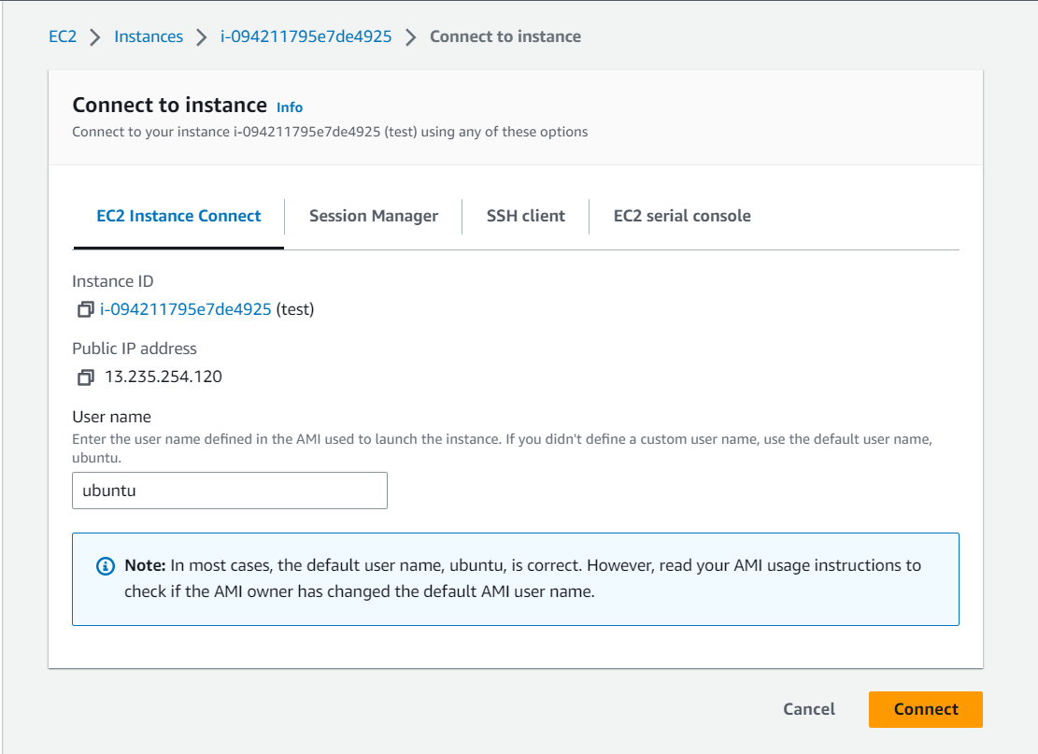
Ec2 connection method
Nand Kishore Ola​

Slide 20
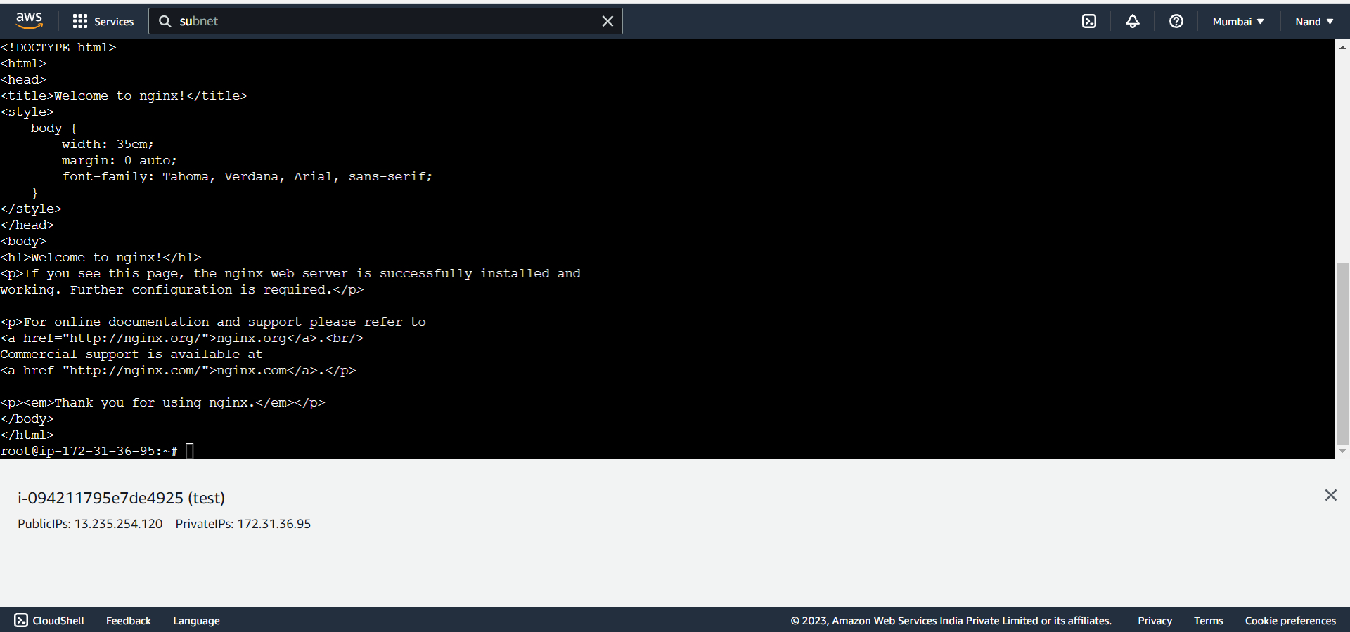
SSH connection from AWS Web
Nand Kishore Ola​

Slide 21
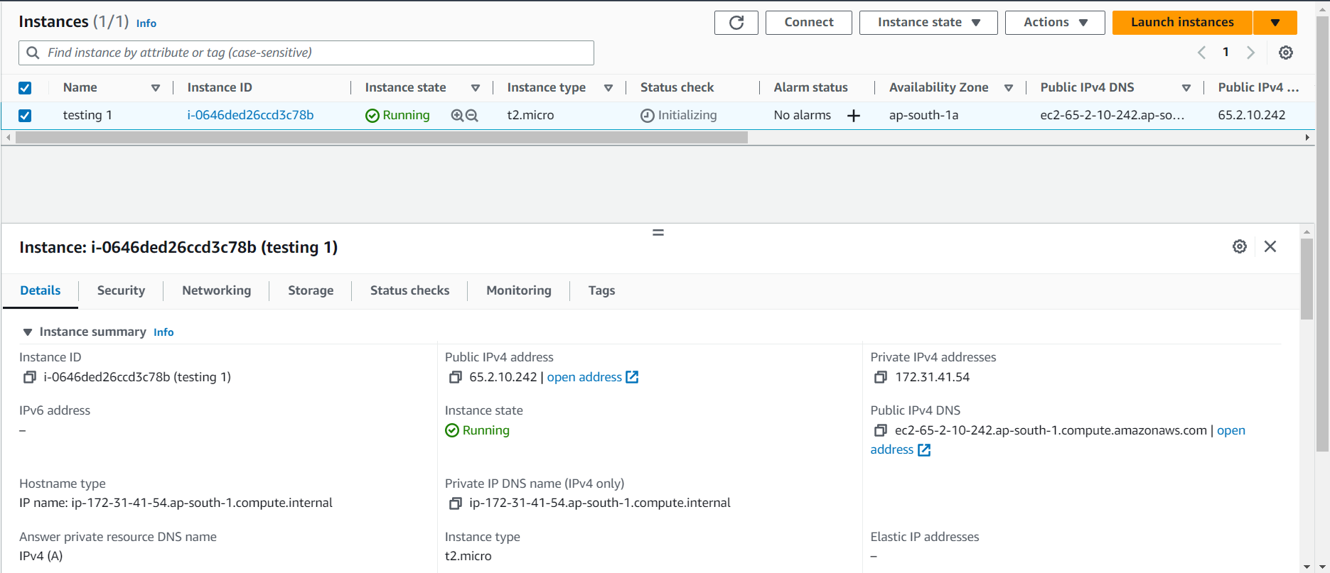
IP Address
Nand Kishore Ola​

Slide 22
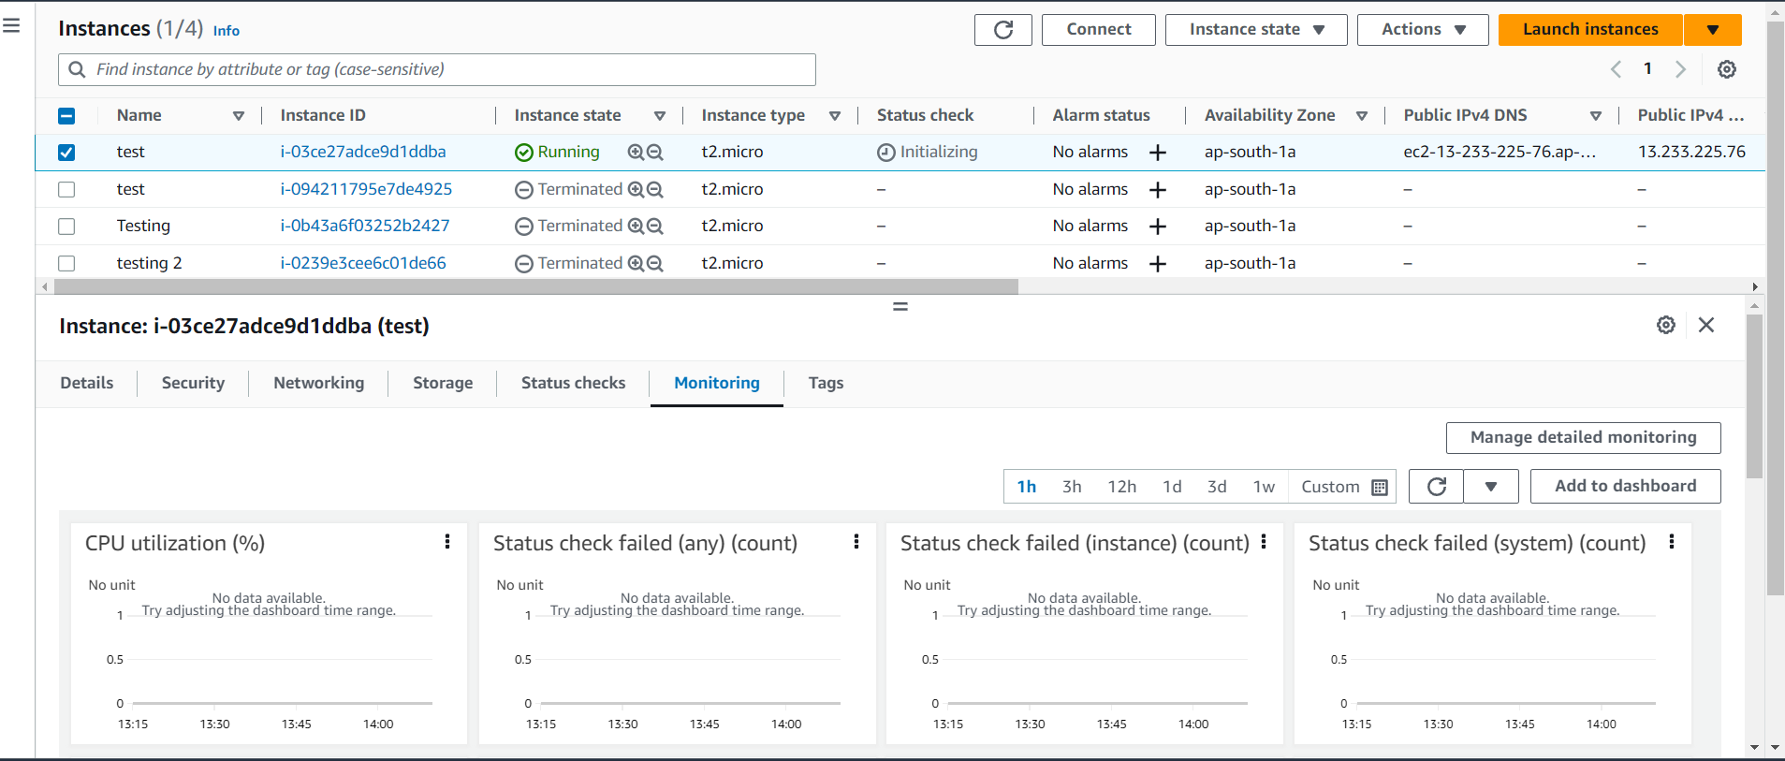
Resource Monitor
Nand Kishore Ola​

Slide 23
Nand Kishore Ola​

Slide 24
Nand Kishore Ola​

Slide 25
Nand Kishore Ola​

Slide 26
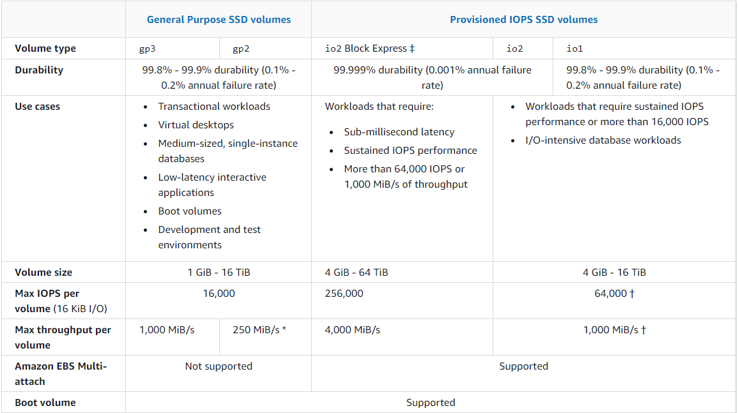
EBS types
Nand Kishore Ola​

Slide 27
Nand Kishore Ola​
Security Practice

Slide 28
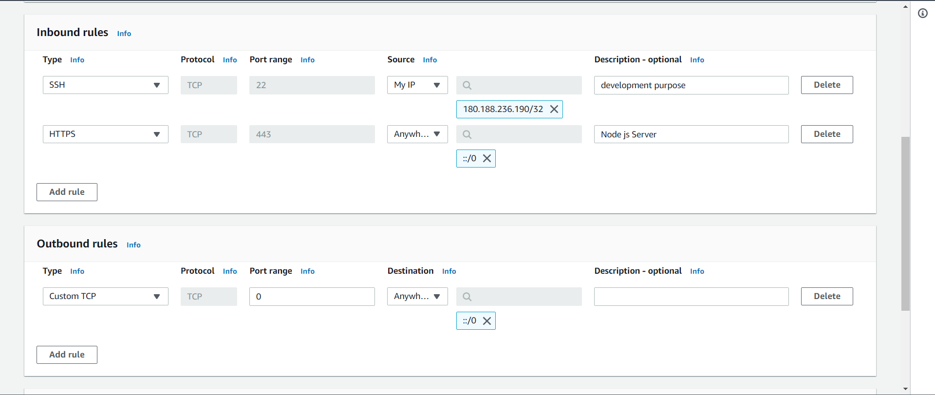
Nand Kishore Ola​

Slide 29
SECURITY GROUPS VISUAL VIEW
Nand Kishore Ola​

Slide 30
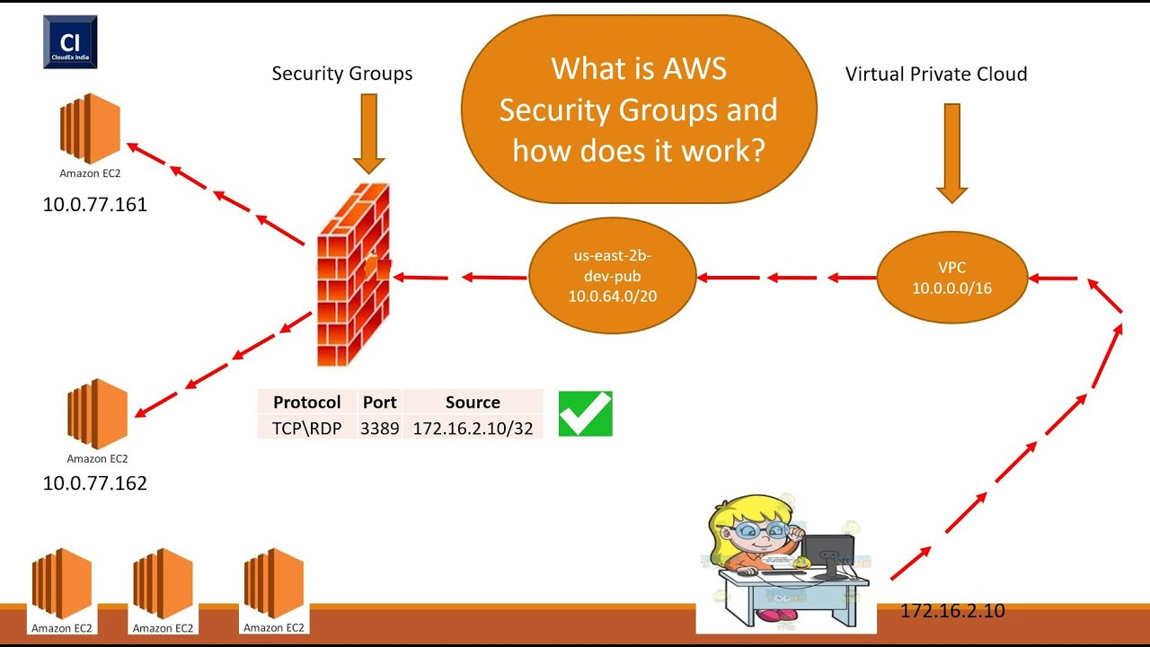
Nand Kishore Ola​

Slide 31
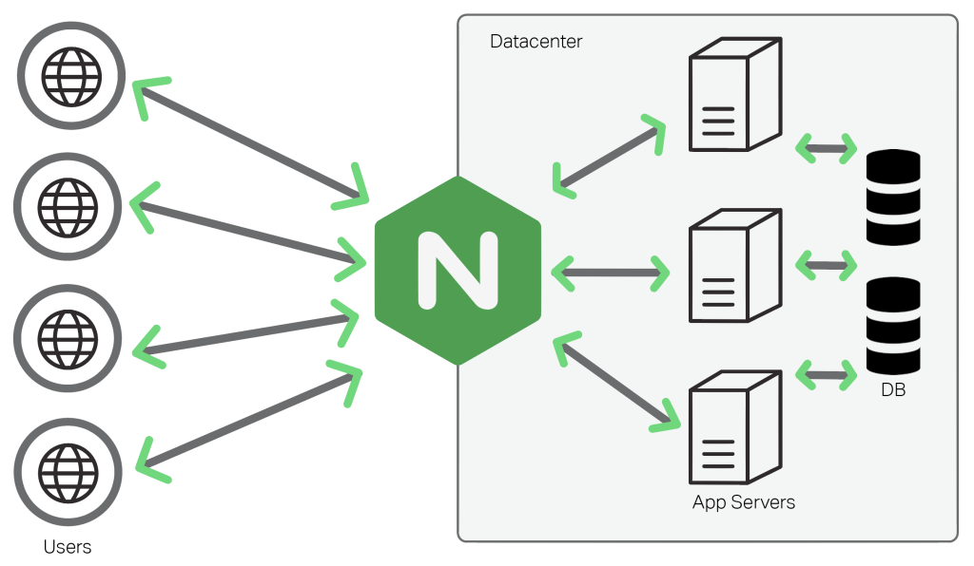
Nand Kishore Ola​

Slide 32
Nand Kishore Ola​

Slide 33
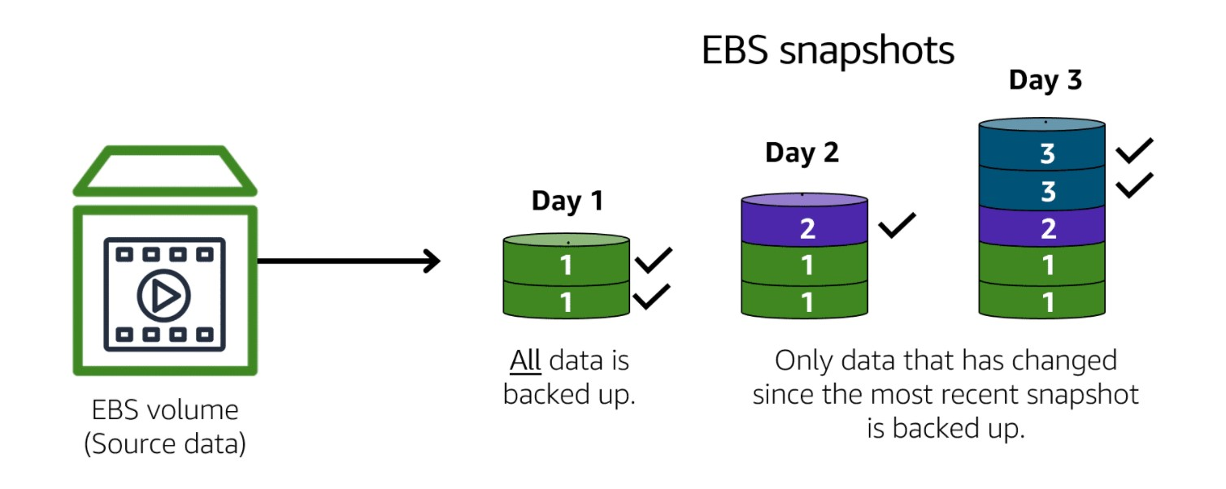
Nand Kishore Ola​

Slide 34
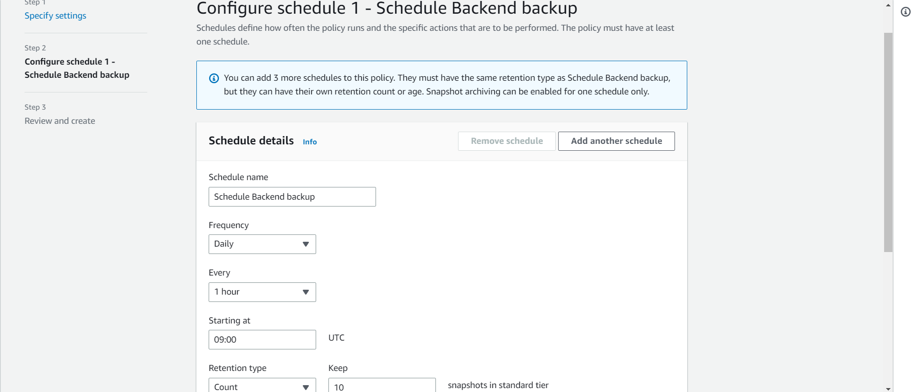
Nand Kishore Ola​

Slide 35
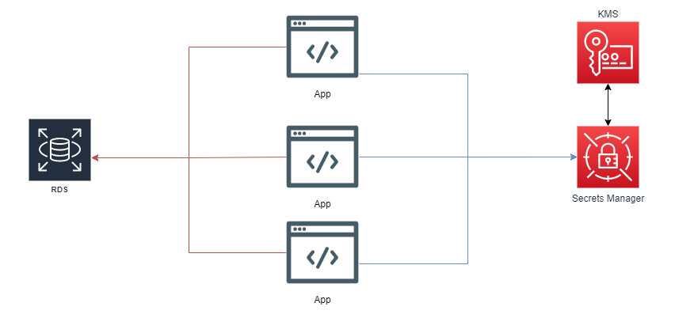
Nand Kishore Ola​

Slide 36
Nand Kishore Ola​
Price Optimization

Slide 37
Nand Kishore Ola​

Slide 38
Nand Kishore Ola​

Slide 39
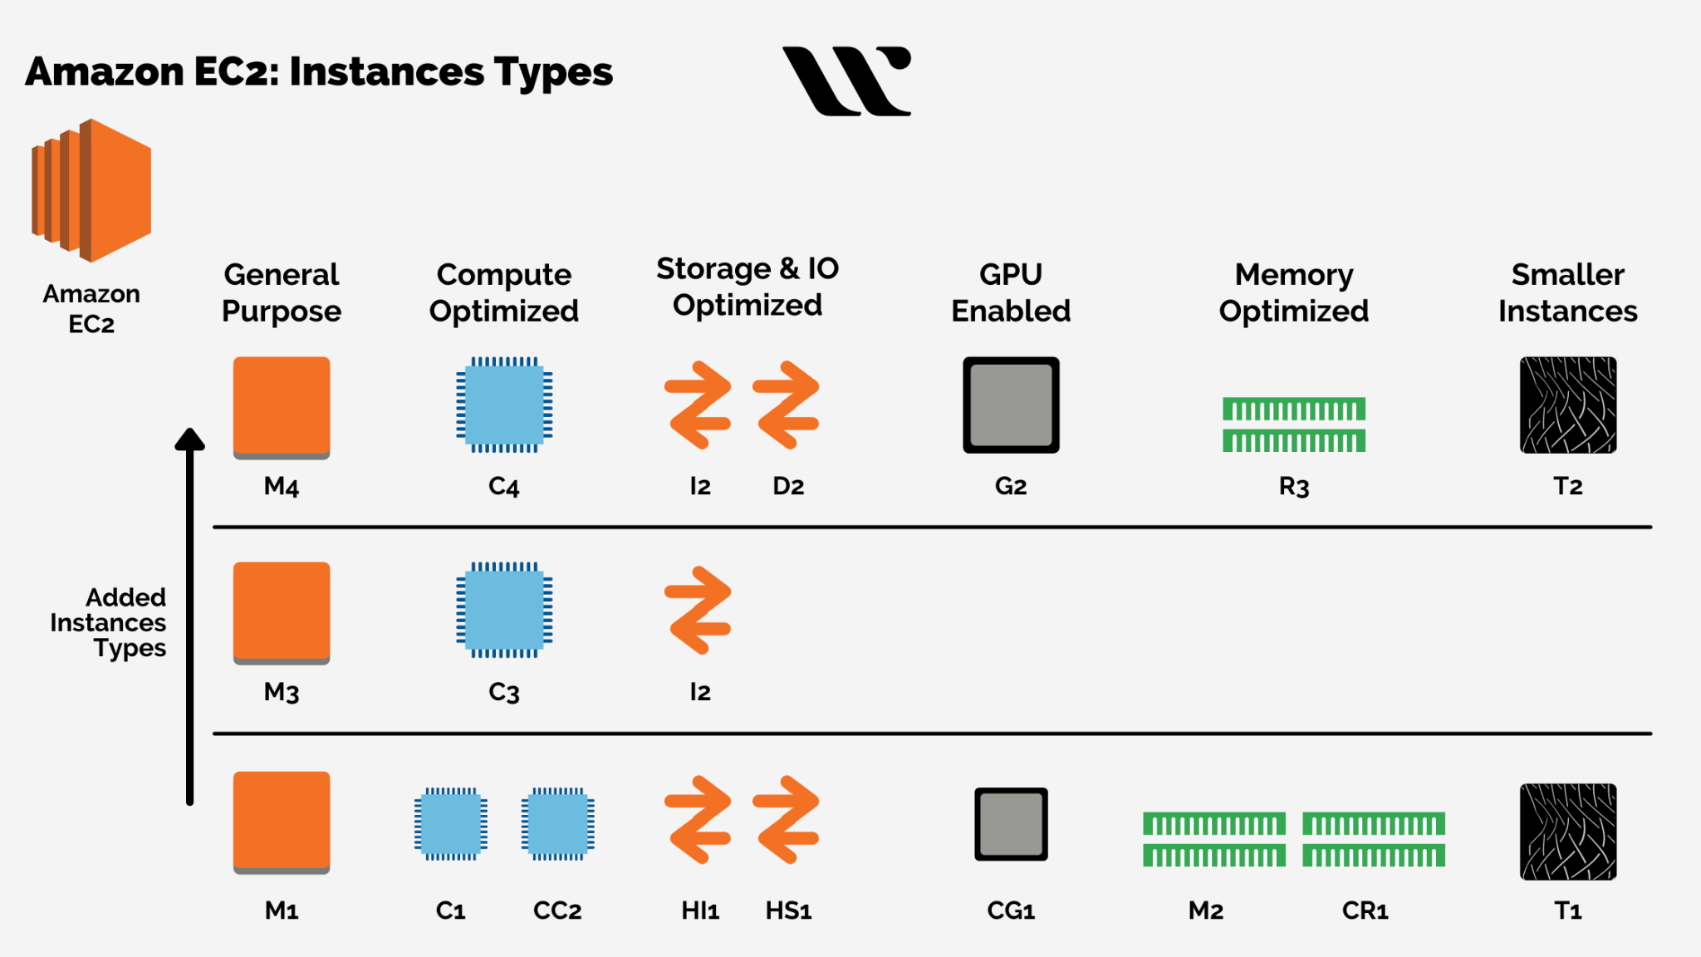
Nand Kishore Ola​

Slide 40
Nand Kishore Ola​

Slide 41
Nand Kishore Ola​

Slide 42
Nand Kishore Ola​

Slide 43
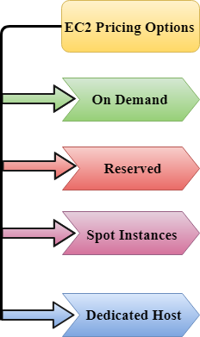
Nand Kishore Ola​

Slide 44
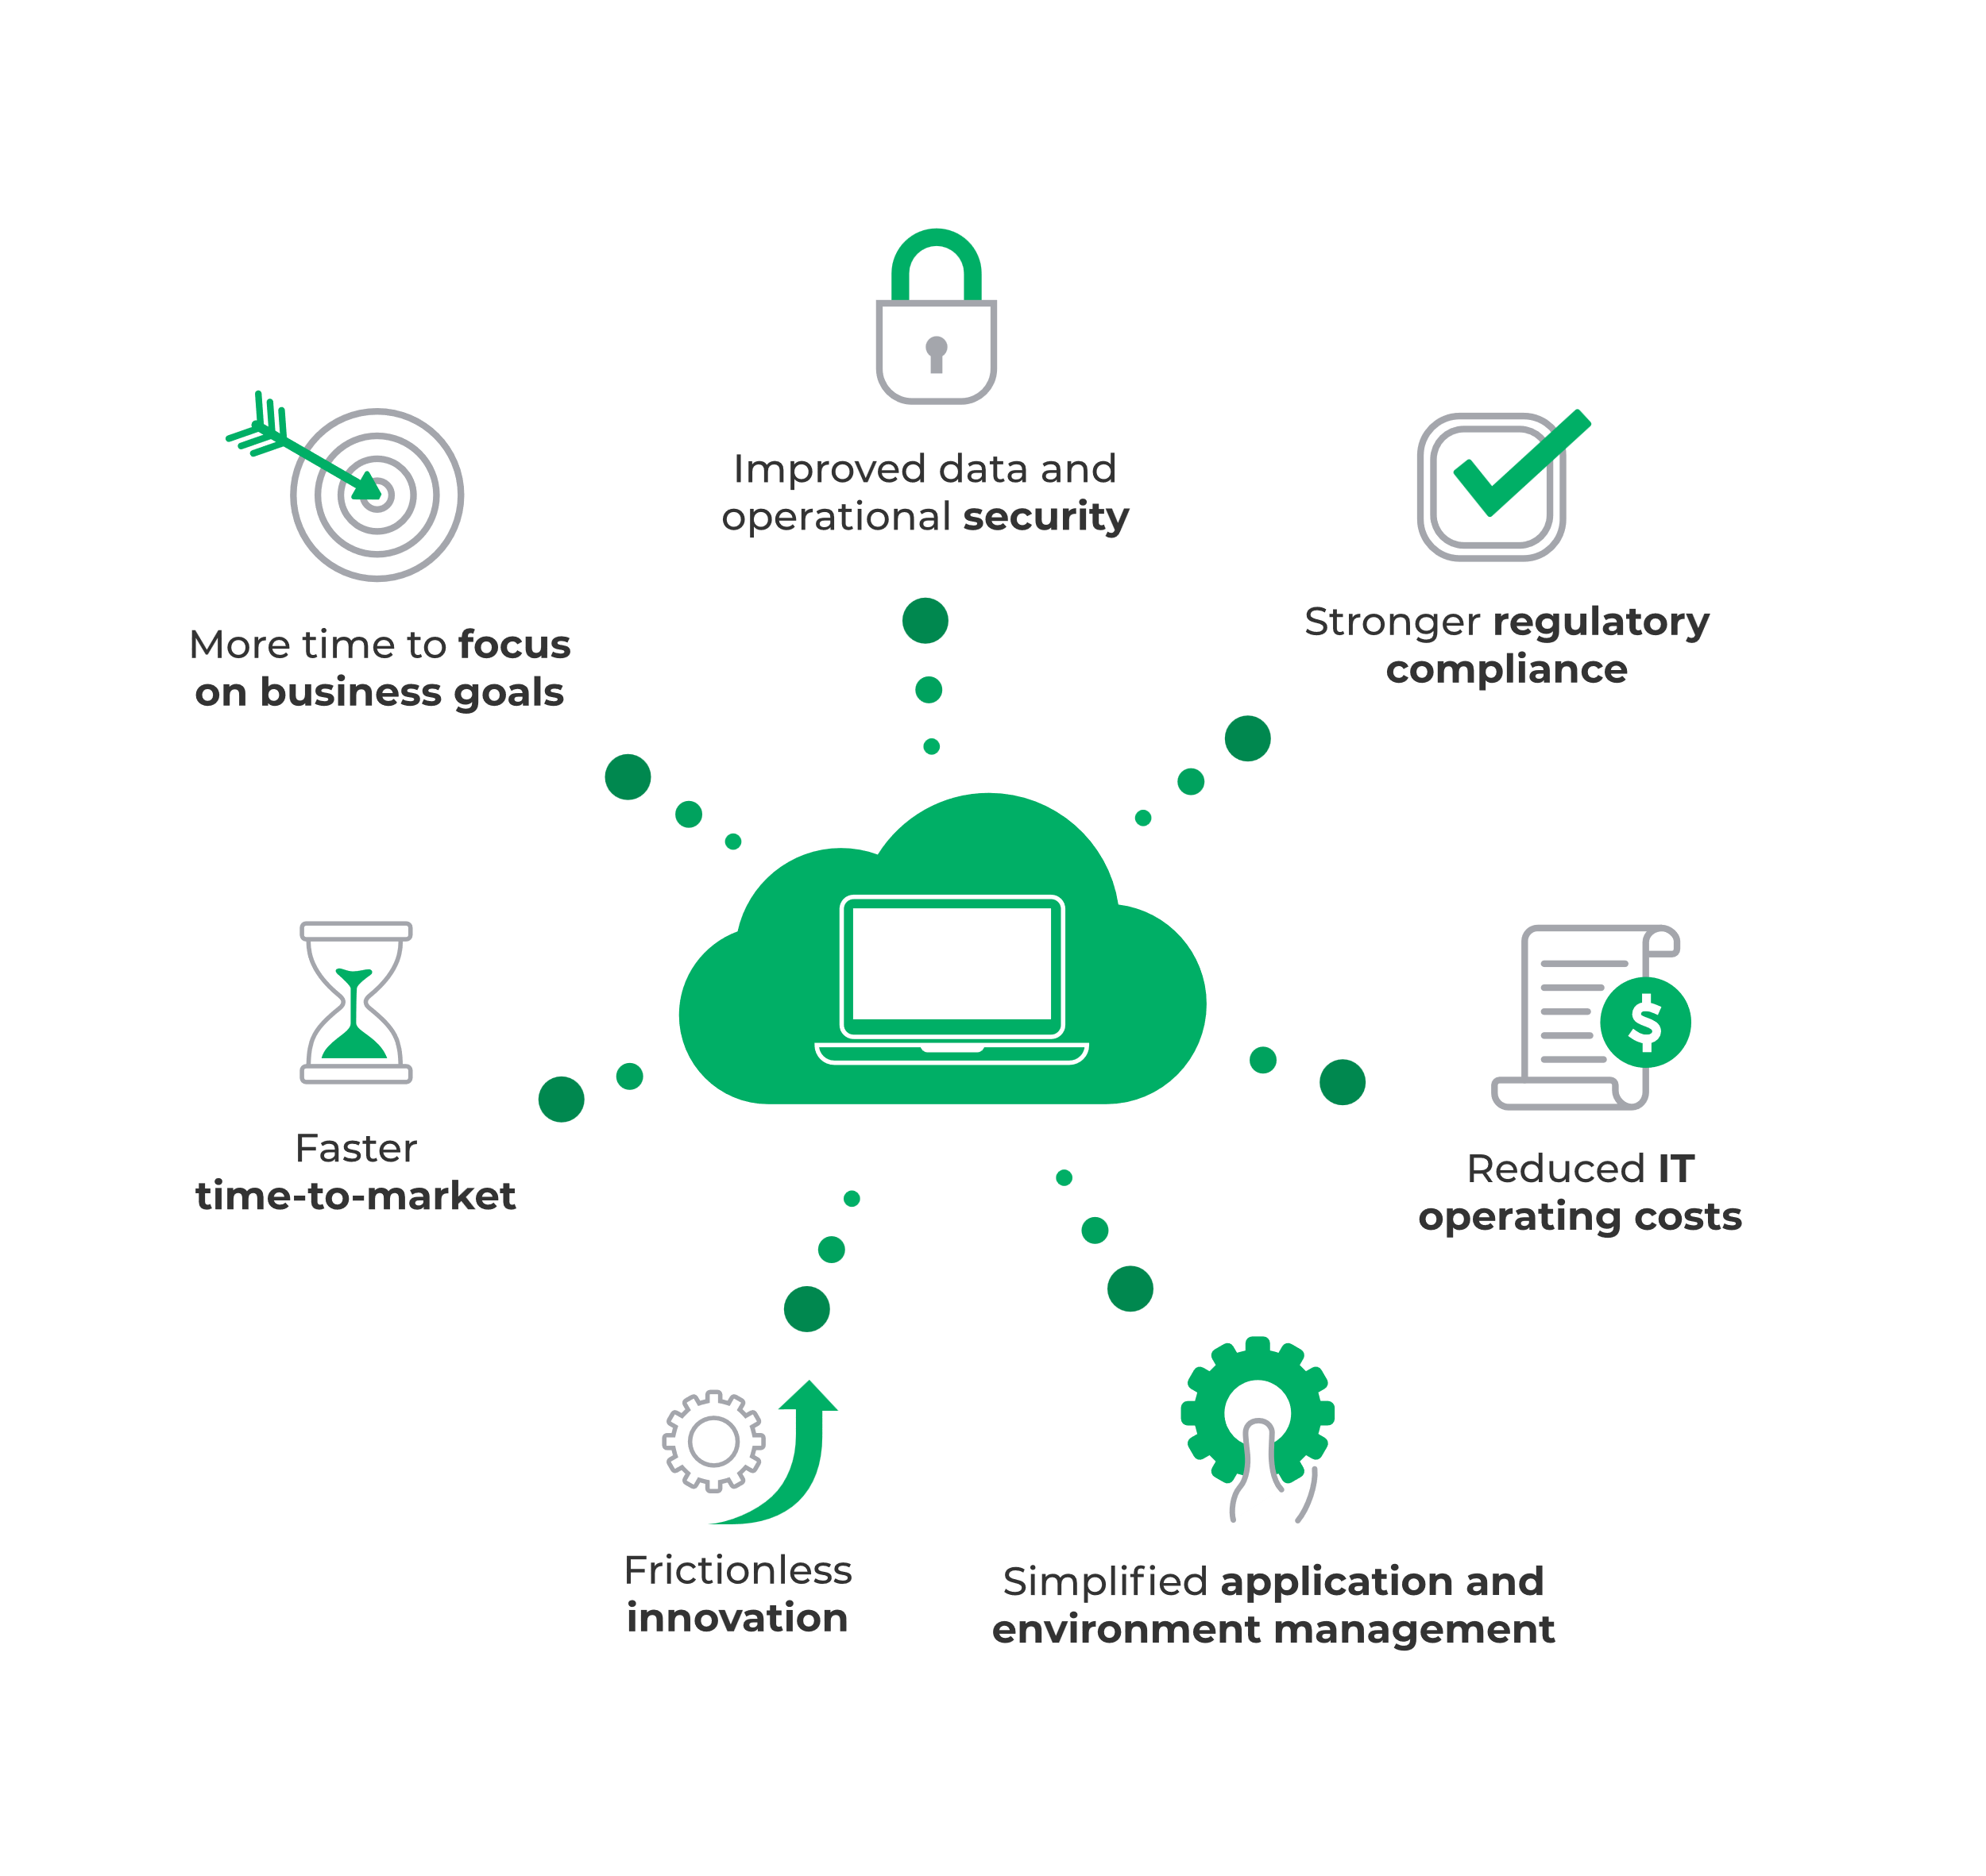
AWS Managed Services
Nand Kishore Ola​

Slide 45
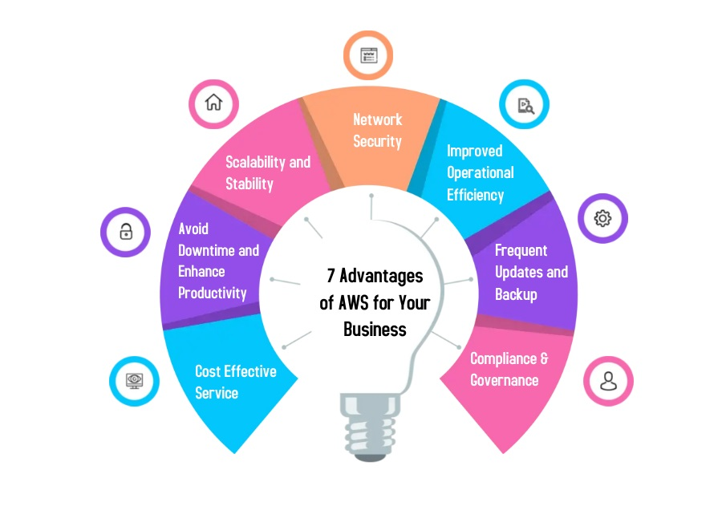
AWS Managed Services Benefit
Nand Kishore Ola​

Slide 46





Development & HOST
Nand Kishore Ola​
Architecture& ci-cd setup
Development
Testing
Git-hub
LAUNCH
First define the architecture of project may be monolithic or micro-service
Now choose any asynchronous framework and do development
Now test on the local system and build the production file
Now push development build file on the git repo
From git-hub you can set direct AWS pipeline to deploy production server

Slide 47
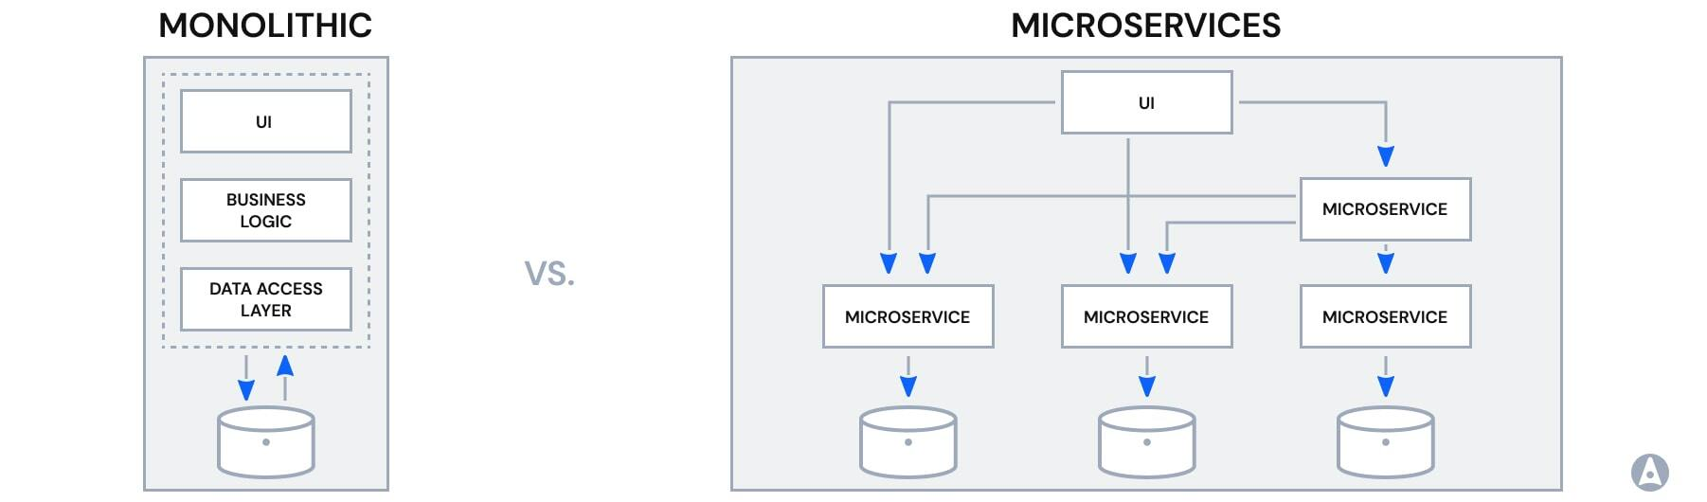
Application architecture
Nand Kishore Ola​

Slide 48
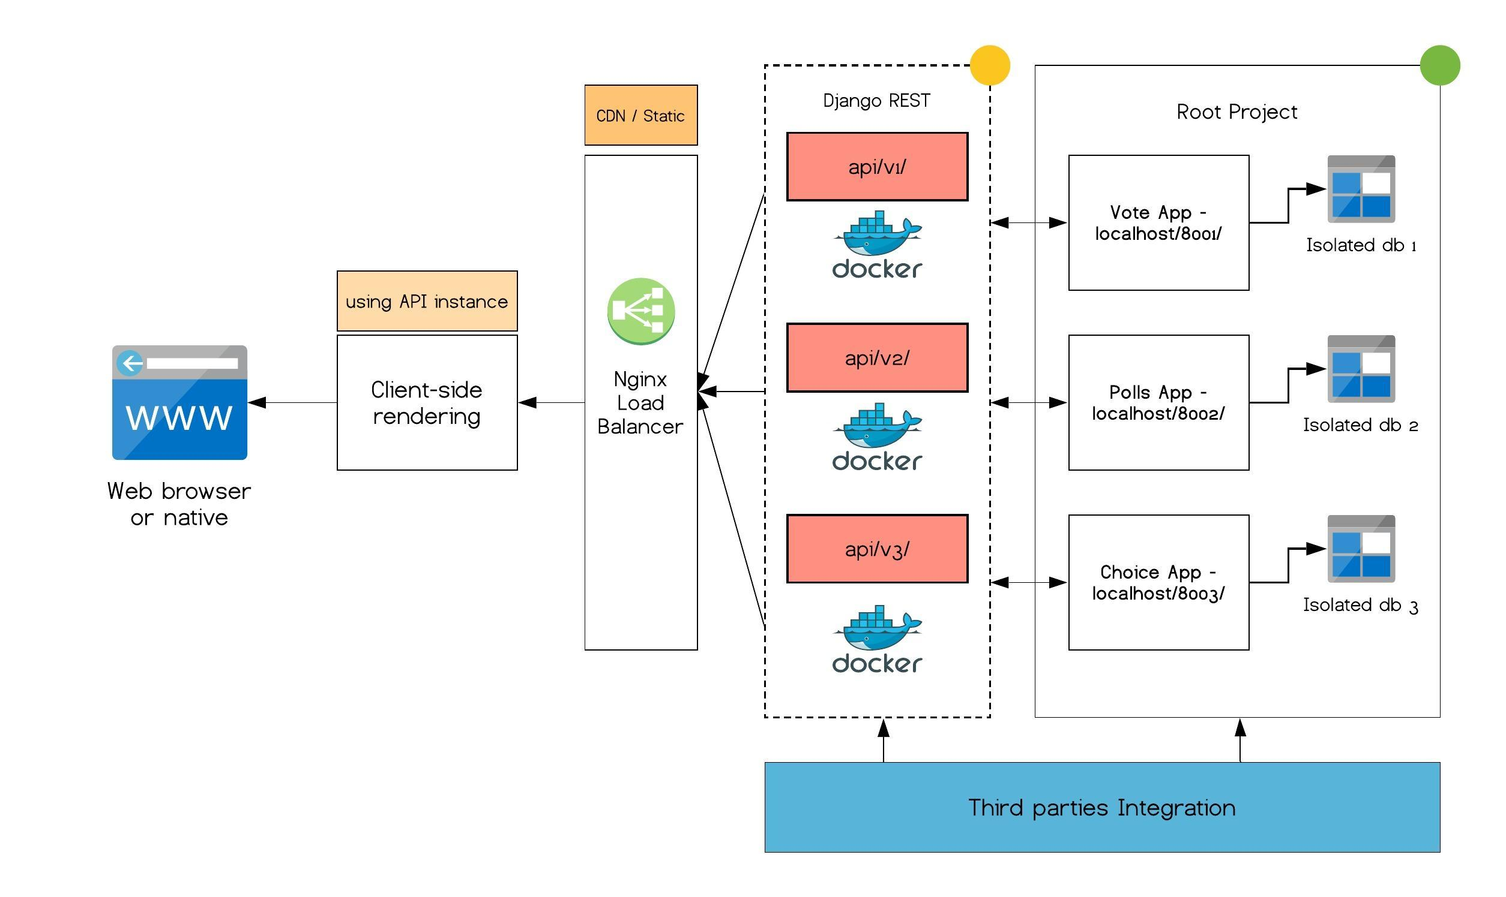
Example
Nand Kishore Ola​

Slide 49
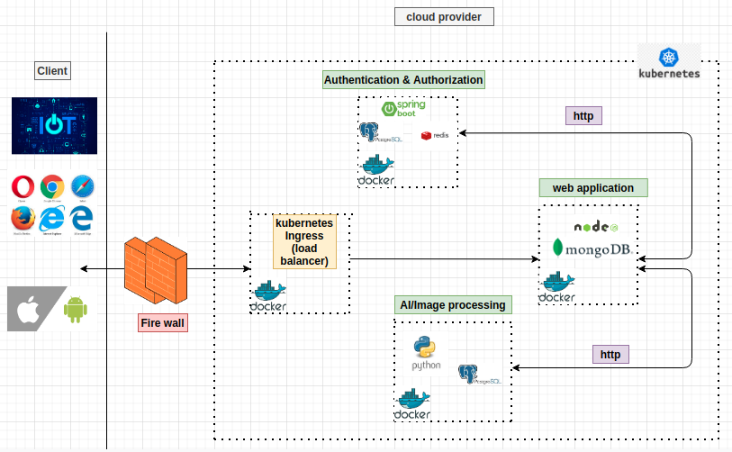
Example
Nand Kishore Ola​

Slide 50
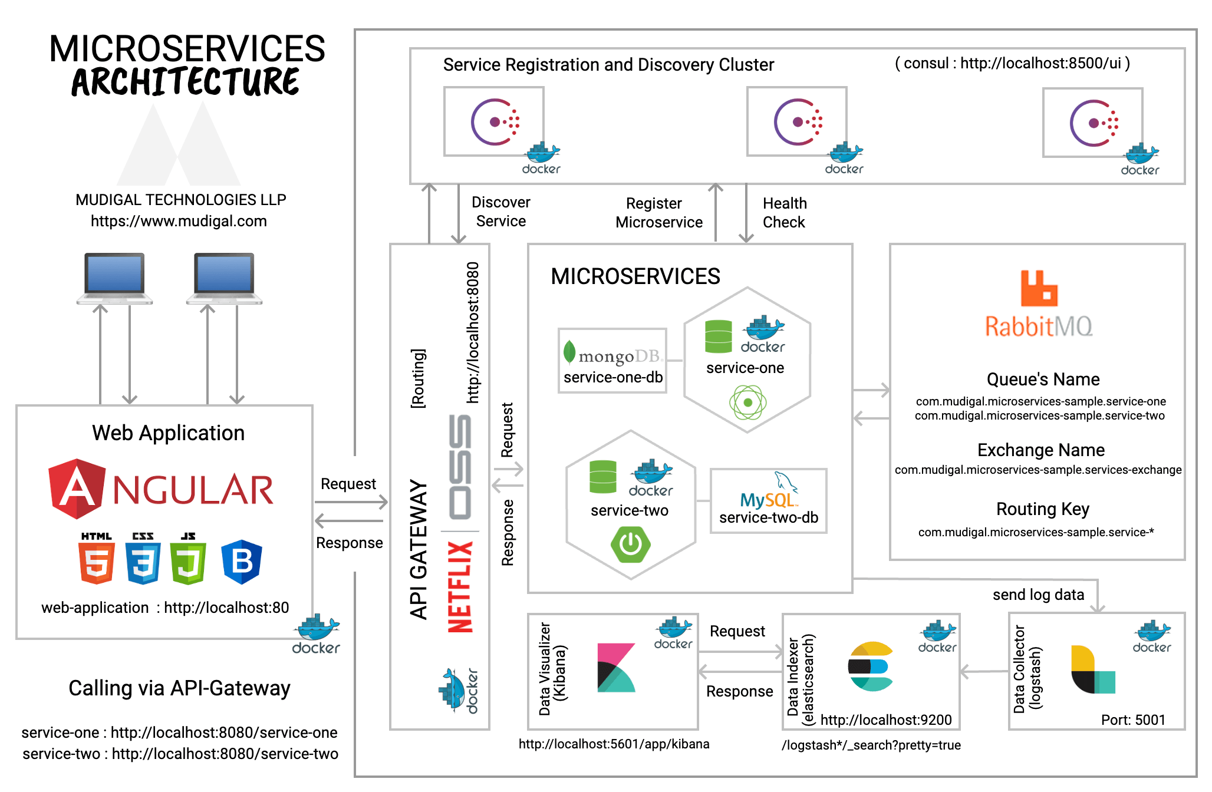
Nand Kishore Ola​

Slide 51
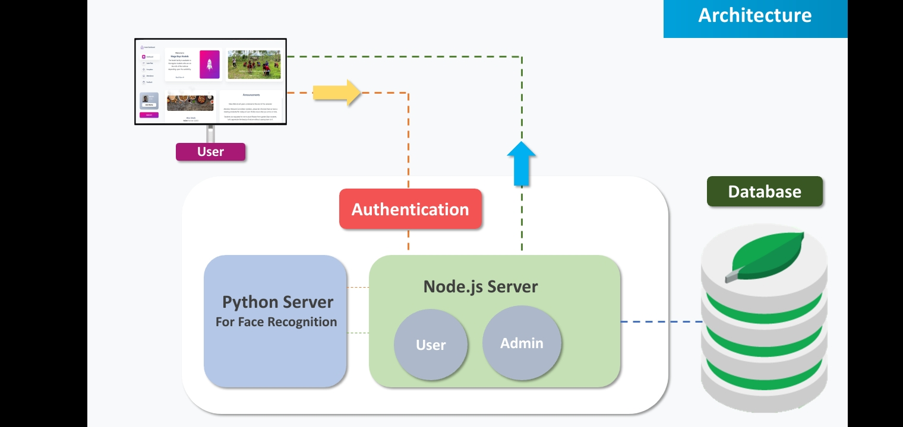
Nand Kishore Ola​

Slide 52
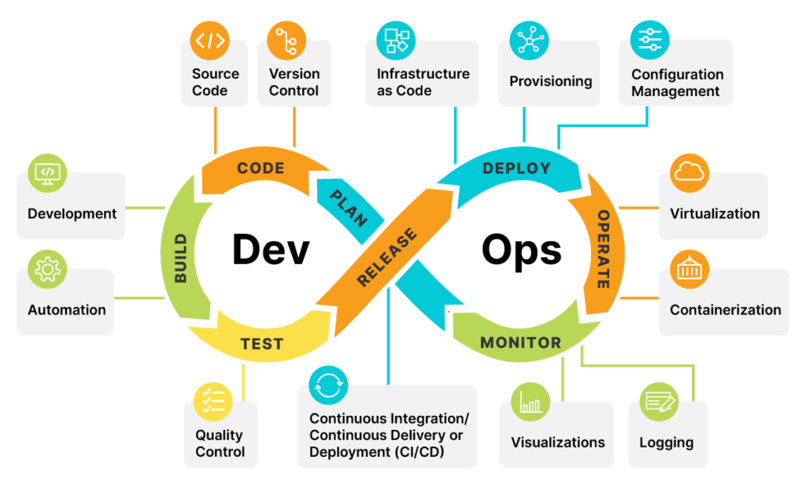
Work Flow in DevOps
Nand Kishore Ola​

Slide 53
Road map for devops
Nand Kishore Ola​
Medium level
Advance level
Linux
Networking
Security
CI/CD
AWS
Infrastructure as code
Programming
Containers
Kubernetes

Slide 54
THANK YOU
Nand Kishore Ola​
AlgoSathi

